Slide 1

Selection Sort Algorithm
Selection sort is an algorithm that selects the smallest element from an unsorted list in each iteration and places that element at the beginning of the unsorted list.
How Selection Sort Works?
Set the first element as minimum. Select first element as minimum Compare minimum with the second element. If the second element is smaller than minimum, assign the second element as minimum. Compare minimum with the third element. Again, if the third element is smaller,
then assign | minimum | to the third element otherwise do nothing. The process

Slide 2
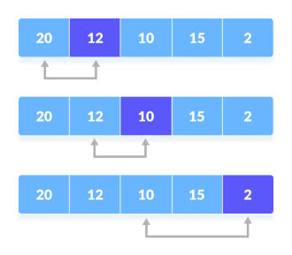
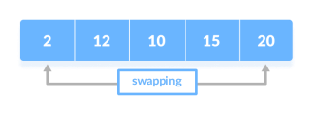
goes on until the last element.
Compare minimum with the remaining elements
3. After each iteration, is placed in the front of the unsorted list.
minimum
Swap the first with minimum

Slide 3
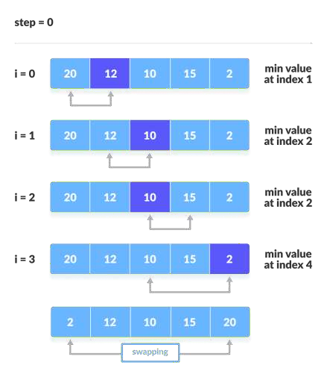
4. For each iteration, indexing starts from the first unsorted element. Step 1 to 3 are repeated until all the elements are placed at their correct positions.

Slide 4
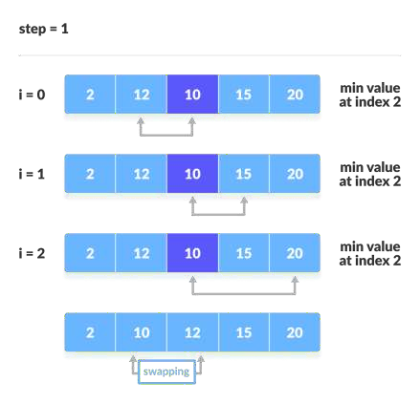
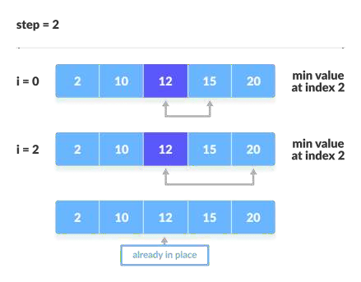

Slide 5
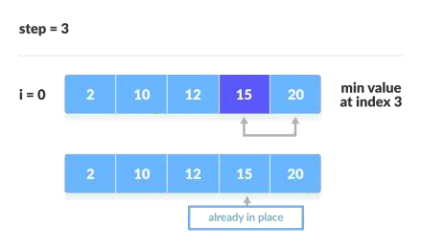
Selection Sort Algorithm
selectionSort(array, size) repeat (size - 1) times
set the first unsorted element as the minimum
for each of the unsorted elements if element < currentMinimum
set element as new minimum
swap minimum with first unsorted position end selectionSort

Slide 6
Complexity
Cycle Number of Comparison
1st (n-1)
2nd (n-2)
3rd (n-3)
... ...
last 1
Number of comparisons:
(n - 1) + (n - 2) + (n - 3) + ..... + 1
= n(n - 1) / 2 nearly equals to n² .
Complexity =
O(n²)
Also, we can analyze the complexity by simply observing the number of loops. There are 2 loops so the complexity is n*n = n² .
Time Complexities:
Worst Case Complexity:
O(n²)
If we want to sort in ascending order and the array is in descending order then, the worst case occurs.
Best Case Complexity:
O(n²)
It occurs when the array is already sorted
Average Case Complexity:
O(n²)
It occurs when the elements of the array are in jumbled order (neither ascending nor descending).
The time complexity of the selection sort is the same in all cases. At every step, you have to find the minimum element and put it in the right place. The minimum element is not known until the end of the array is not reached.

Slide 7
Space Complexity:
Space complexity is
O(1)
because an extra variable
temp
is used.
Selection Sort Applications
The selection sort is used when:
a small list is to be sorted cost of swapping does not matter checking of all the elements is compulsory cost of writing to a memory matters like in flash memory (number of
writes/swaps is | O(n) | as compared to | O(n²) | of bubble sort)

Slide 8
Bubble Sort Algorithm
Bubble sort is an algorithm that compares the adjacent elements and swaps their positions if they are not in the intended order. The order can be ascending or descending.
How Bubble Sort Works?
1. Starting from the first index, compare the first and the second elements.If the first element is greater than the second element, they are swapped.
Now, compare the second and the third elements. Swap them if they are not in order.
The above process goes on until the last element.

Slide 9
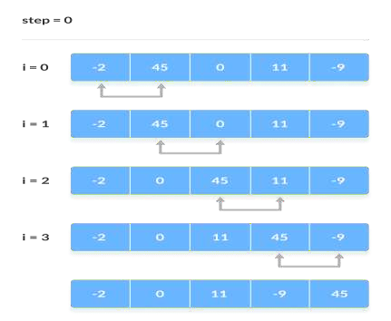
Compare the adjacent
elements
2. The same process goes on for the remaining iterations. After each iteration, the largest element among the unsorted elements is placed at the end.
In each iteration, the comparison takes place up to the last unsorted element. The array is sorted when all the unsorted elements are placed at their correct

Slide 10
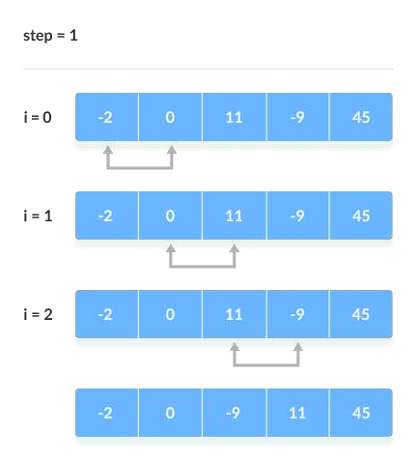
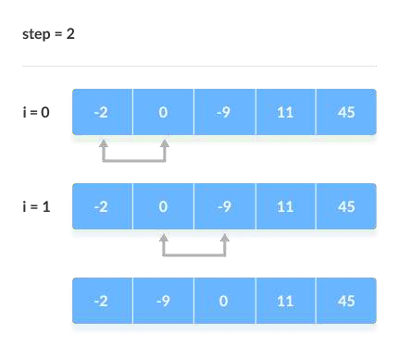
positions.
Compare the
adjacent elements
Compare

Slide 11
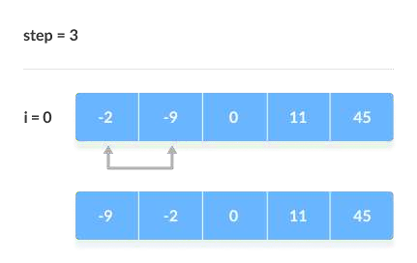
the adjacent elements
Compare the adjacent elements
Bubble Sort Algorithm
bubbleSort(array)
for i <- 1 to indexOfLastUnsortedElement-1 if leftElement > rightElement
swap leftElement and rightElement
end bubbleSort
Complexity

Slide 12
Bubble Sort is one of the simplest sorting algorithms. Two loops are implemented in the algorithm.
Cycle Number of Comparisons
1st
(n-1)
2nd
(n-2)
3rd
(n-3)
.......
......
last
1
Number of comparisons:
(n - 1) + (n - 2) + (n - 3) +.....+ 1 = n(n - 1) /
2 nearly equals to n²
Complexity:
O(n²)
Also, we can analyze the complexity by simply observing the number of loops.
There are 2 loops so the complexity is
Time Complexities:
n*n = n²
Worst Case Complexity:O(n²)
If we want to sort in ascending order and the array is in descending order then, the worst case occurs.
Best Case Complexity:O(n)
If the array is already sorted, then there is no need for sorting.
Average Case Complexity:O(n²)
It occurs when the elements of the array are in jumbled order (neither ascending nor descending).

Slide 13
Space Complexity:
Space complexity is
O(1)
because an extra variable is used for swapping.
temp
In the optimized algorithm, the variable adds to the space complexity thus, making it O(2).
swapped
Bubble Sort Applications
Bubble sort is used in the following cases where
the complexity of the code does not matter.
a short code is preferred.

